Slide 1

CSCI E-96: Case Study #1
Jim Lee, John Daly, Ramon Delacruz, Geoffrey Small
YouTube: https://youtu.be/sFNDA_34dyo

Slide 2
OkCupid : Summary
Our analysis of the profile data using R tools allowed us to find areas for opportunities and create questions that could be used for marketing strategies.
Interesting observations were found in 4 categories:
Ethnicity
Gender
Age
Income
About the data:
The analysis was done with the profile data containing 59,944 profiles (2 outliers were removed)
Users who have not logged on since date last_online date - 2012-07-01 were removed to better reflect the active population
Users in the dataset reside in the state of California with a large aggregation in the Bay Area

Slide 3
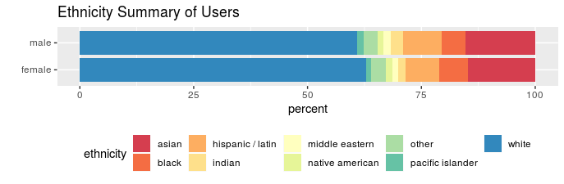
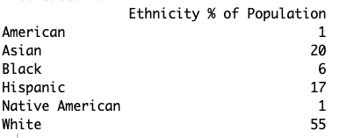
Ethnicity Findings & Opportunities
Summary & Findings
OK Cupid Ethnicity
High white population of users, in line with census data
Tend to be more male users in minority groups, except in black population. White population has more females.
About 15% of users as Asian, significantly lower than census data as a %
% of Hispanic users in relation to census data is also low
Largest Total Addressable Markets (TAM) in California are White, Asian and Hispanic groups
Census Data Ethnicity
Recommendation
Adjust marketing campaign to attract more white males
Aggressively pursue Asian & Hispanic markets as there is room to grow significantly there
Don’t invest in ethnic marketing outside of White, Black & Asian groups as TAM is low in other group.
Notes:
This shift to a theater blueprint will drive us to measure success with a new lens as well. We’ve identified these core metrics across 4 categories – People, Customers, Financials, Business Metrics – to help us define a holistic view of “success” looks like for CX.

Slide 4
Gender Disparity
Taking a look at the gender ratio of the total population, we see our distribution of genders on OkCupid shown below
Male ♂ count is 35,829 (~60% of the user base)
Female ♀ count is 24,117 (~40% of the user base)
Given the target of OkCupid is to (supposedly) match one male user with one female user, there is a clear lack of female users on the system – which is an approachable market to build

Slide 5
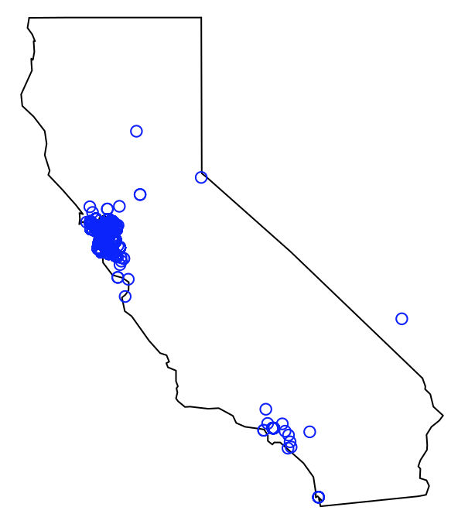
Deep Dive: Location (California)
The initial deep dive will be to target where users in this data set are
Remove the inactive users (users who have not logged on since a year of the most recent date last_online date - 2012-07-01)
We see that most users reside in the state of California with a large aggregation in the Bay Area

Slide 6
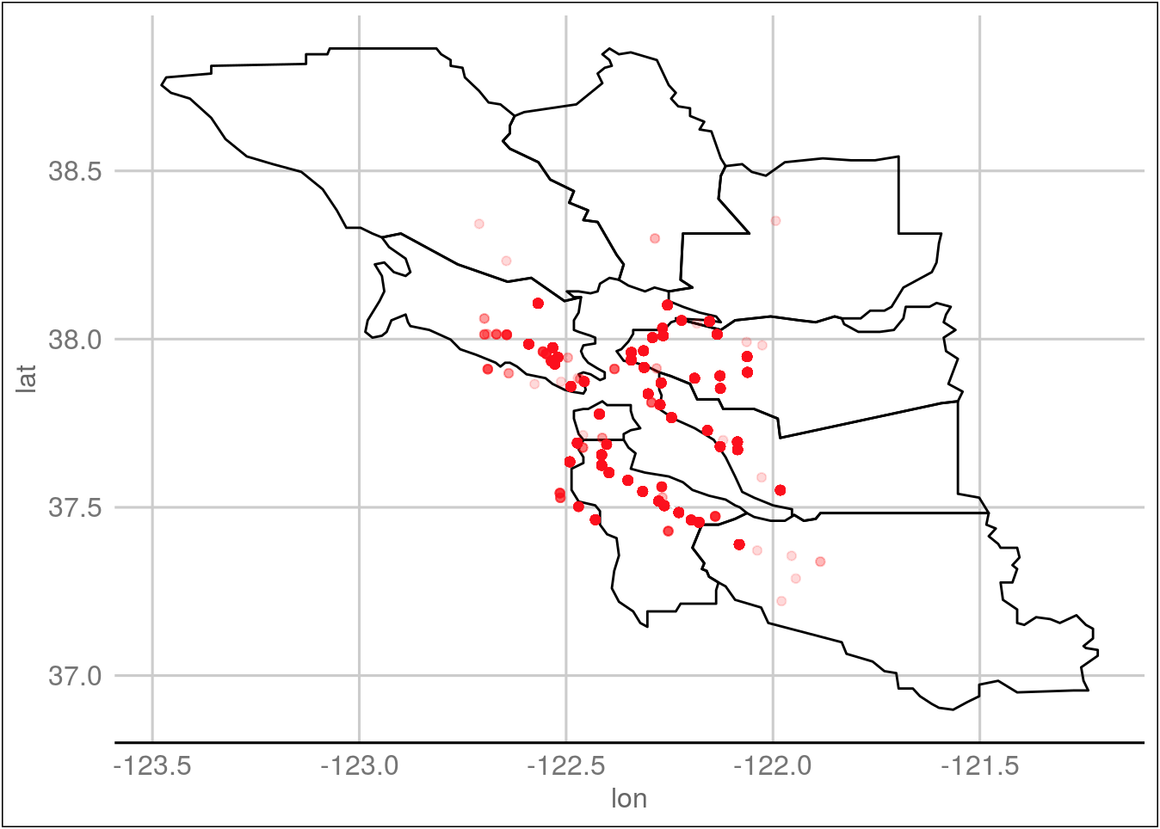
Deep Dive: The Bay Area
Bay Area County | Total Number of Active Users
San Francisco County | 27,209
Alameda County | 13,208
San Mateo County | 4,793
Contra Costa County | 2,728
Marin County | 1,590
Solano County | 674
Santa Clara County | 348
Above is an analysis of the seven most active user populations in the Bay Area
The total active users in San Francisco is nearly twice the size of the next largest active user pool

Slide 7
Deep Dive: The Bay Area
Bay Area Cities | Total Number of Active Users
San Francisco | 27,209
Oakland | 6,278
Berkeley | 3,711
San Mateo | 1,145
Palo Alto | 922
Alameda | 814
More specifically – we can target specific cities to better understand the patterns of each individual Bay Area city.

Slide 8
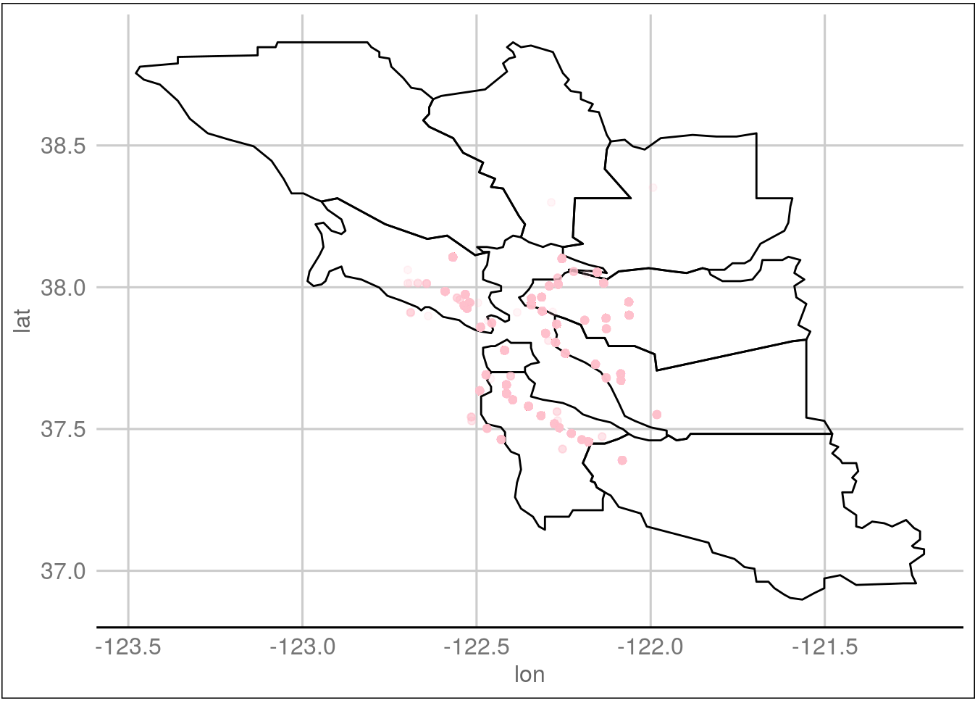
City to City Comparisons
Oakland:
Female User Proportion (48.4%)
Comparing the female user proportions, we see a notable difference in two Bay Area cities: San Francisco and Oakland
These two cities also represent the two highest user group populations (27,209 for SF and 6,278 for Oakland)
San Francisco:
Female User Proportion (39.6%)

Slide 9
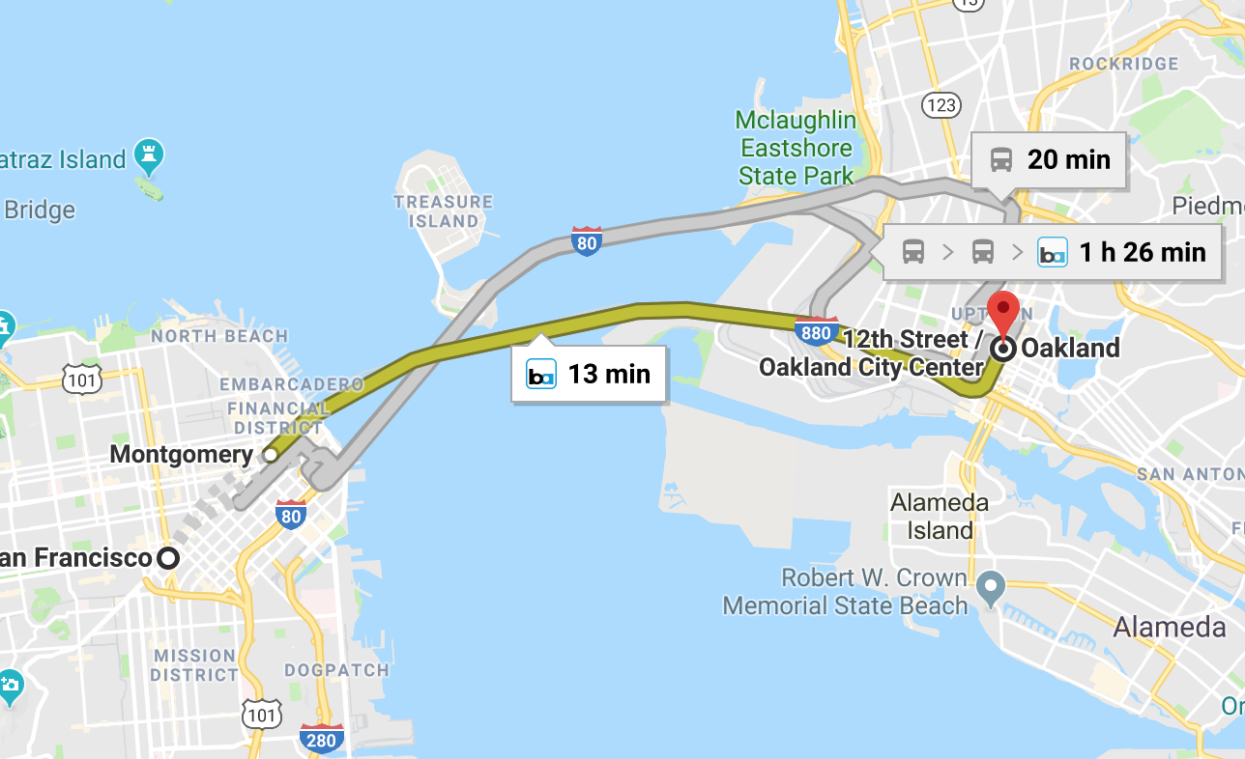
San Francisco vs. Oakland
Only 12.6 miles apart separated by a bridge (and 13 minutes by Public Transportation)
Why are the populations so different?

Slide 10
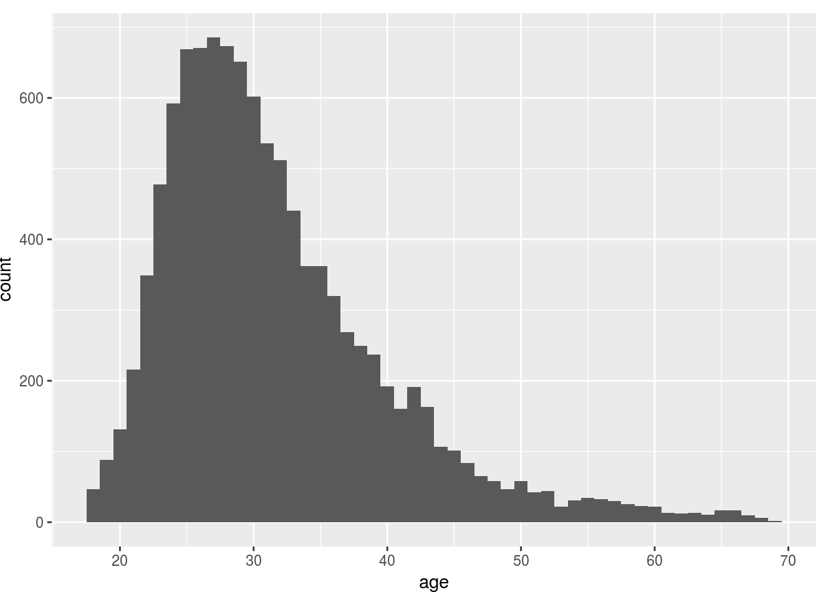
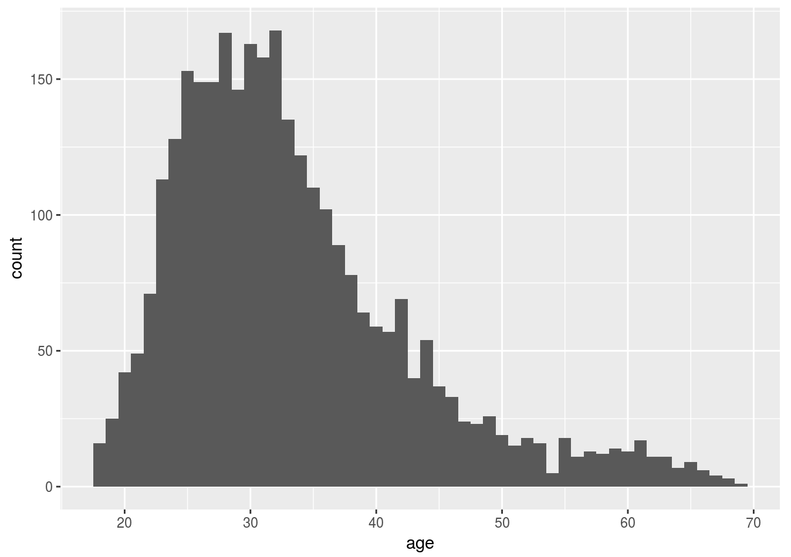


San Francisco vs. Oakland
San Francisco Female Age Distribution
Oakland Female Age Distribution

Slide 11
San Francisco vs. Oakland
Potentially marketing towards female users between 30-40 may reduce the gender gap
Other areas for marketing research and user growth based on SF vs Oakland differences:
Open bar events targeting those interested via “drinks” question to bring an unregistered friend
Targeting niche language groups

Slide 12
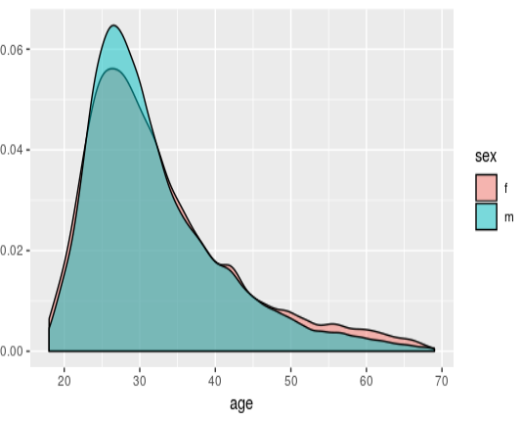
Age Distribution
Found Outliers of age 100+ and were removed from data
Distribution of age among gender is balanced
Most users are in the range between 25-35 age group
Marketing should focus on age group less <50 for higher chance of matching
Data includes inactive users which could be misleading

Slide 13
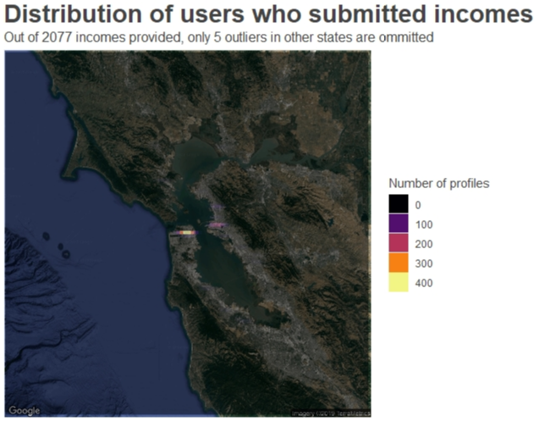
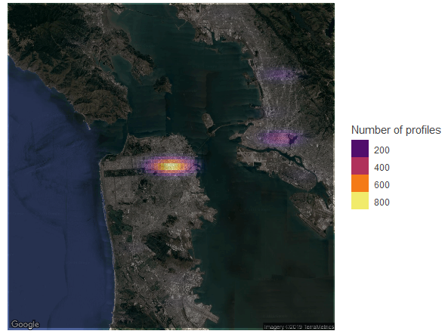
Geographic Income Densities
Figure GS.1: Heat map of the Bay Area, where both the number of profile incomes and average incomes were the highest. As evident on the left, San Francisco has the highest density.

Slide 14
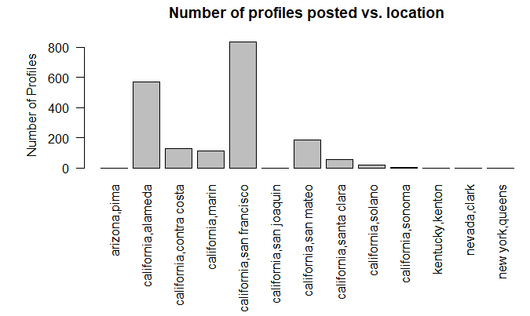
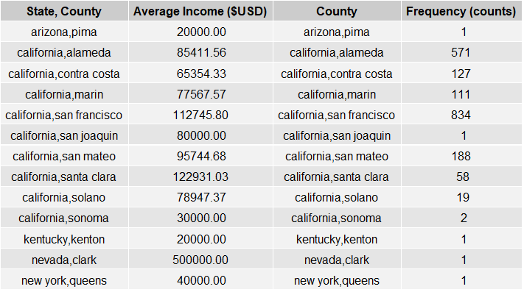
Geographic Income Densities
Figure GS.2: Plot of number of profiles posted with income information. This plot is supplemental to the heatmap in Fig. GS.1
Table GS.1: Comprehensive data of profiles with respective mean incomes, per geographic region. San Francisco had, by far, the largest number of profiles with income data. Additionally, this region had one of the highest mean incomes in the sample distribution

Slide 15
Apart from a negligibly-small subset of the sample size, many of the high-earning users provided incomes on their profiles
This suggests that higher-earning users may be more likely to submit income data
With such data, user satisfaction may be improved by constructing algorithms to suggest potential matches with other high-income users. If a user changes location settings to encompass a broader geographic radius, then users in the closest high income region would take preference in suggested matches
One may also share such information with outside parties for advertising purposes, if the terms and conditions of the application permit
Significance of The Data

Slide 16
Summary of Recommendations
Ethnicity
Target appropriate ethnic groups in the marketing strategy and campaigns as it relates to addressable markets
Gender
Target female gender proportions in the San Francisco area by marketing to women ages 30-40 to improve the gender ratio
Explore other disparities by comparing to the Oakland area since it is has more ideal gender distribution and similar demographics to San Francisco
Age
Market to an age group of 35 and older in order to compete with dating apps such as Match.com, EliteSingles and eHarmony who target older users
Income
Suggest potential matches in similar income brackets to potentially increase user satisfaction. Can share income data with external parties for targeted advertising purposes

